Slide 1
Data Structure and Algorithms

Slide 2
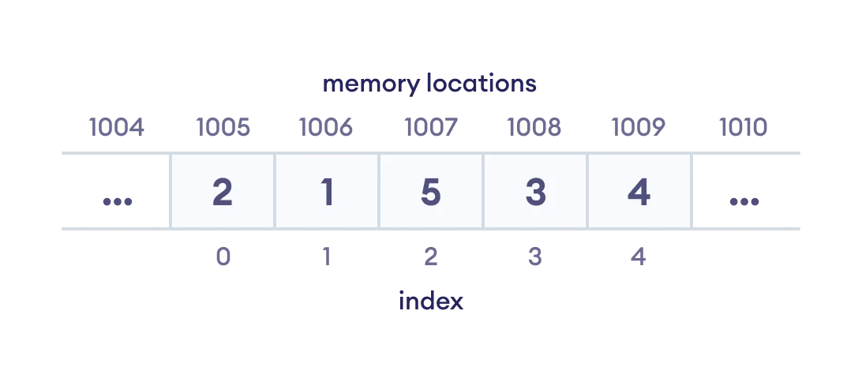
Data Structure and Types
What are Data Structures?
Data structure is a storage that is used to store and organize data.
It is a way of arranging data on a computer so that it can be accessed and updated efficiently.
Depending on your requirement and project, it is important to choose the right data structure for your project.
For example, if you want to store data sequentially in the memory, then you can go for the Array data structure.
Ex: Array data Structure Representation

Slide 3
Types of Data Structure
Basically, data structures are divided into two categories:
Linear data structure.
Non-linear data structure.

Slide 4
1. Linear data structures
In linear data structures, the elements are arranged in sequence one after the other.
Since elements are arranged in particular order, they are easy to implement.
However, when the complexity of the program increases, the linear data structures might not be the best choice because of operational complexities.
Types of Linear data structures
Array Data Structure
Stack Data Structure
Queue Data Structure
Linked List Data Structure

Slide 5
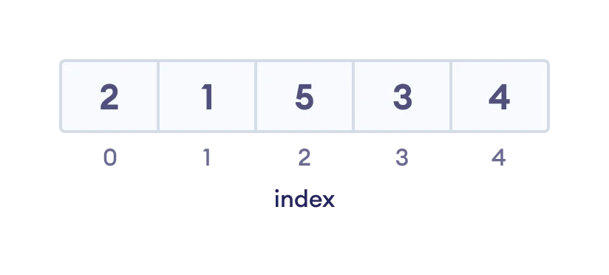
1. Array Data Structure
In an array, elements in memory are arranged in continuous memory.
All the elements of an array are of the same type.
And, the type of elements that can be stored in the form of arrays is determined by the programming language.
Ex: An array with each element represented by an index

Slide 6
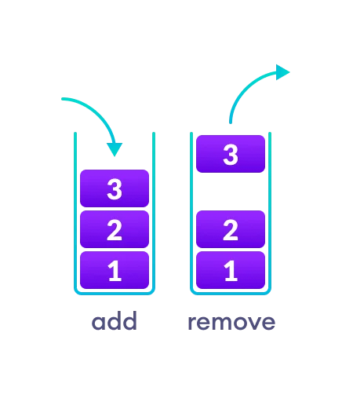
2. Stack Data Structure
In stack data structure, elements are stored in the LIFO principle. That is, the last element stored in a stack will be removed first.
It works just like a pile of plates where the last plate kept on the pile will be removed first.
Ex: In a stack, operations can be perform only from one end (top here).

Slide 7
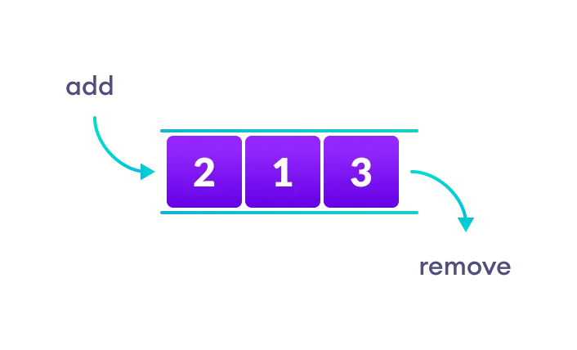
3. Queue Data Structure
Unlike stack, the queue data structure works in the FIFO principle where first element stored in the queue will be removed first.
It works just like a queue of people in the ticket counter where first person on the queue will get the ticket first.
Ex: In a queue, addition and removal are performed from separate ends.

Slide 8
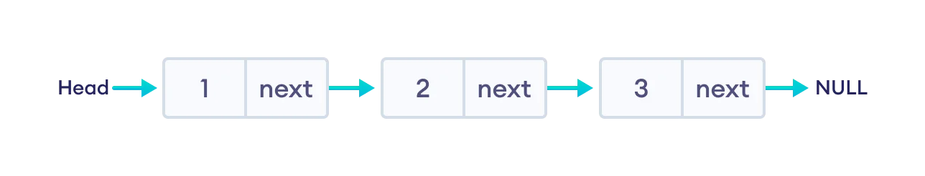
4. Linked List Data Structure
In linked list data structure, data elements are connected through a series of nodes. And, each node contains the data items and address to the next node.
Ex: A linked list

Slide 9
2. Non linear data structures
Unlike linear data structures, elements in non-linear data structures are not in any sequence.
Instead they are arranged in a hierarchical manner where one element will be connected to one or more elements.
Types of Non linear data structures
1. Graph Data Structure.
2. Trees Data Structure.

Slide 10
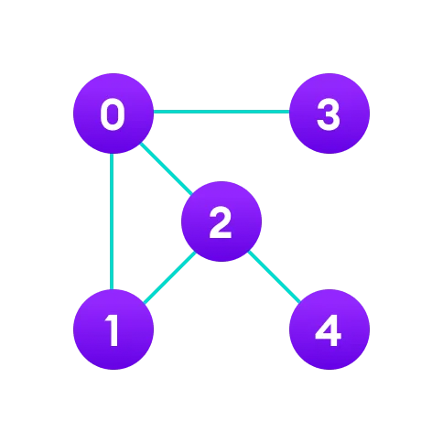
1. Graph Data Structure.
In graph data structure, each node is called vertex and each vertex is connected to other vertices through edges.
Ex: Graph data structure

Slide 11
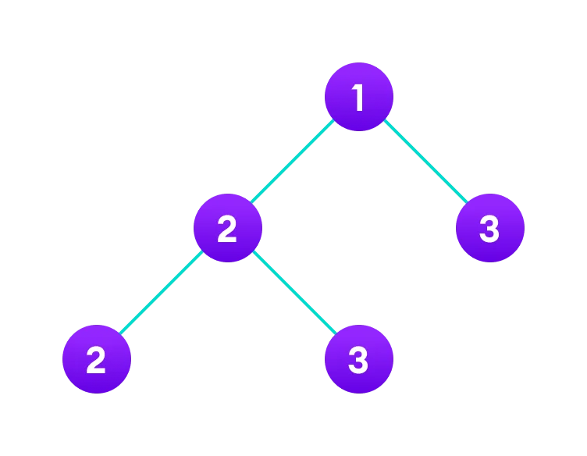
2. Trees Data Structure
Similar to a graph, a tree is also a collection of vertices and edges. However, in tree data structure, there can only be one edge between two vertices.
Ex: Tree data structure

Slide 12
Fundamentals of data structures
The following four data structures are used ubiquitously in the description of algorithms and serve as basic building blocks for realizing more complex data structures.
Sequences (also called as lists)
Dictionaries
Priority Queues
Graphs
Dictionaries and priority queues can be classified under a broader category called dynamic sets.
Binary and general trees are very popular building blocks for implementing dictionaries and priority queues.

Slide 13
Dictionaries
• A dictionary is a general-purpose data structure for storing a group of objects.
• A dictionary has a set of keys and each key has a single associated value.
• When presented with a key the dictionary will return the associated value.
• A dictionary is also called a hash, a map, a hashmap in different programming languages.

Slide 14
Dictionaries
• For example the results of a classroom test could be represented as a dictionary with pupil's names as keys and their scores as the values.
• results = { 'Detra' : 17,
'Nova' : 84,
'Charlie' : 22,
'Henry' : 75,
'Roxanne' : 92,
'Elsa' : 29 }
• Instead of using the numerical index of the data we can use the dictionary names to return values.
>>> results['Nova’]
84
>>> results['Elsa’]
29

Slide 15
Dictionaries
• The keys in a dictionary must be simple types (such as integers or strings) while the values can be of any type.
• Different languages enforce different type restrictions on keys and values in a dictionary.
• Dictionaries are often implemented as hash tables.
• Keys in a dictionary must be unique an attempt to create a duplicate key will typically overwrite the existing value for that key.

Slide 16
Dictionaries
• Dictionary is an abstract data structure that supports the following operations:
search(K key) (returns the value associated with the given key)
insert(K key, V value)
delete(K key)
• Each element stored in a dictionary is identified by a key of type K.
• Dictionary represents a mapping from keys to values.

Slide 17
Dictionaries
Dictionaries have numerous applications.
contact book
• key: name of person; value:
telephone number table of program variable identiers
• key: identier; value: address in memory
property-value collection
• key: property name; value: associated value
natural language dictionary
• key: word in language X; value: word in language Y.

Slide 18
Operations on dictionaries
• Dictionaries typically support several operations:
retrieve a value (depending on language, attempting to retrieve a missing key may give a default value or throw an exception).
insert or update a value (typically, if the key does not exist in the dictionary, the key-value pair is inserted; if the key already exists, its corresponding value is overwritten with the new one).
remove a key-value pair.
test for existence of a key.
• Note that items in a dictionary are unordered, so loops over dictionaries will return items in an arbitrary order.

Slide 19
Complexity of Algorithms
It is very convenient to classify algorithms based on the relative amount of time or relative amount of space they require and specify the growth of time /space requirements as a function of the input size.
• Time Complexity: Running time of the program as a function of the size of input.
• Space Complexity: Amount of computer memory required during the program execution, as a function of the input size.

Slide 20
Algorithm Analysis
• What is an algorithm?
• Algorithm is a set of steps to complete a task. For example,
• Task: to make a cup of tea.
• Algorithm:
add water and milk to the kettle.
Boil it.
add tea leaves.
Add sugar.
and then serve it in cup.

Slide 21
Algorithm Analysis
• What is Computer algorithm?
a set of steps to accomplish or complete a task that is described precisely enough that a computer can run it.

Slide 22
Algorithm Analysis
Characteristics of an algorithm:-
Must take an input.
Must give some output(yes/no, value etc.)
Definiteness– each instruction is clear and unambiguous.
Finiteness– algorithm terminates after a finite number of steps.
Effectiveness– every instruction must be basic i.e. simple instruction.

Slide 23
Algorithm Analysis
• An Algorithm is a sequence of steps to solve a problem.
• The Analysis of Algorithm is very important for designing algorithm to solve different types
of problems in the branch of computer science and information technology.
• In the analysis of algorithms, it is common to estimate their complexity in the asymptotic
sense.
• To estimate the complexity function for arbitrarily large input.

Slide 24
Algorithm Analysis
• Expectation from an algorithm
Resource usage:
• The time is considered to be the primary measure of efficiency.
• We are also concerned with how much the respective algorithm involves the computer memory.
• But mostly time is the resource that is dealt with.
• And the actual running time depends on a variety of backgrounds: like the speed of the Computer, the language in which the algorithm is implemented, the compiler/interpreter,
skill of the programmers etc.
• Mainly the resource usage can be divided into:
1.Memory (space)
2.Time

Slide 25
• Time taken by an algorithm?
Performance measurement or A postoriori Analysis:
• Implementing the algorithm in a machine and then calculating the time taken by the system to execute the program successfully.
Performance Evaluation or A priori Analysis.
• Before implementing the algorithm in a system. This is done as follows
How long the algorithm takes :-
• will be represented as a function of the size of the input.
• f(n)→how long it takes if ‘n’ is the size of input.
How fast the function that characterizes the running time grows with the input size.
• “Rate of growth of running time”.
• The algorithm with less rate of growth of running time is considered better.

Slide 26
Asymptotic Analysis: Big-O Notation and More
The efficiency of an algorithm depends on the amount of time, storage and other resources required to execute the algorithm.
The efficiency is measured with the help of asymptotic notations.
An algorithm may not have the same performance for different types of inputs. With the increase in the input size, the performance will change.
The study of change in performance of the algorithm with the change in the order of the input size is defined as asymptotic analysis.

Slide 27
Asymptotic Notations
Asymptotic notations are the mathematical notations used to describe the running time of an algorithm when the input tends towards a particular value or a limiting value.
For example: In bubble sort, when the input array is already sorted, the time taken by the algorithm is linear i.e. the best case.
But, when the input array is in reverse condition, the algorithm takes the maximum time (quadratic) to sort the elements i.e. the worst case.
When the input array is neither sorted nor in reverse order, then it takes average time. These durations are denoted using asymptotic notations.

Slide 28
There are mainly three asymptotic notations:
Big-O notation.
Omega notation.
Theta notation.

Slide 29
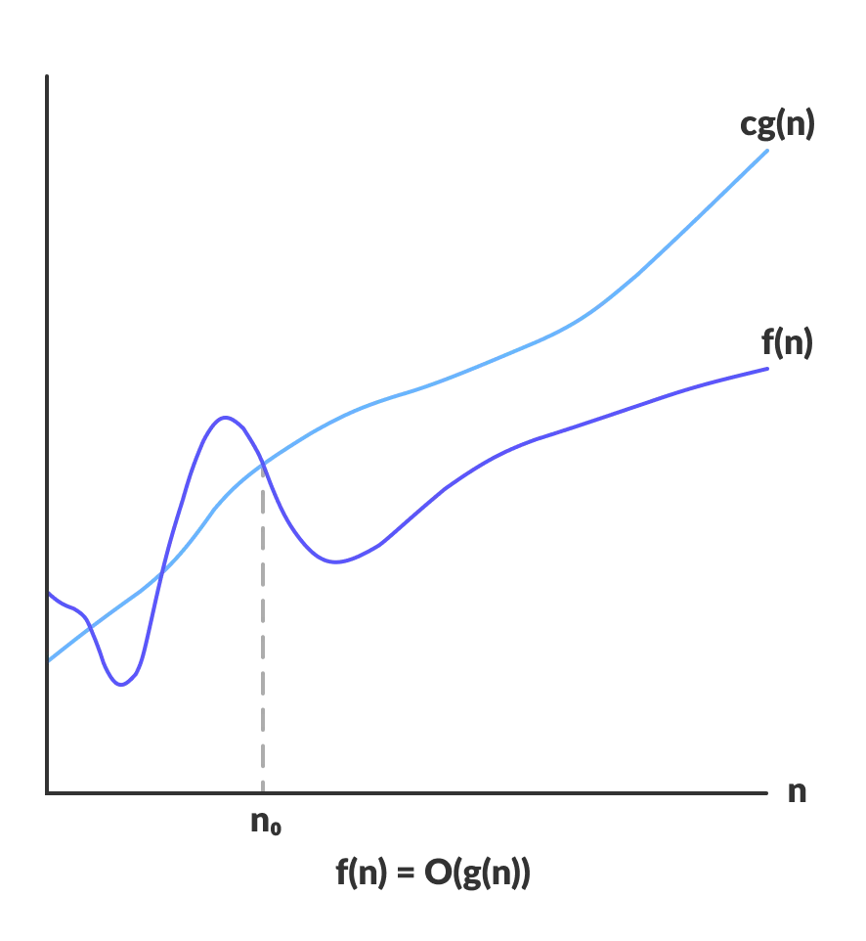
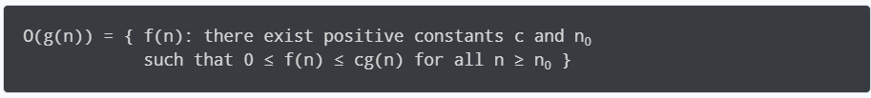
Big-O Notation (O-notation)
Big-O notation represents the upper bound of the running time of an algorithm. Thus, it gives the worst-case complexity of an algorithm.
Ex: Big-O gives the upper bound of a function

Slide 30
The above expression can be described as a function f(n) belongs to the set O(g(n)) if there exists a positive constant c such that it lies between 0 and cg(n), for sufficiently large n.
For any value of n, the running time of an algorithm does not cross the time provided by O(g(n)).
Since it gives the worst-case running time of an algorithm, it is widely used to analyze an algorithm as we are always interested in the worst-case scenario.

Slide 31
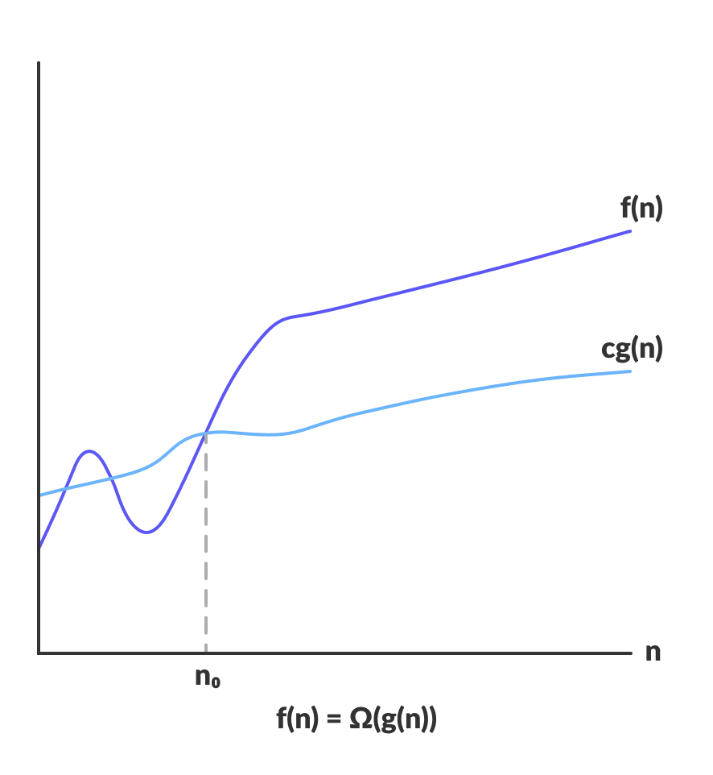
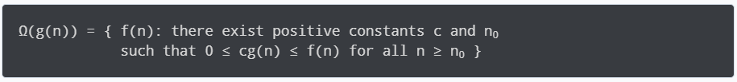
2. Omega Notation (Ω-notation)
Omega notation represents the lower bound of the running time of an algorithm. Thus, it provides the best case complexity of an algorithm.
Ex: Omega gives the lower bound of a function.

Slide 32
The above expression can be described as a function f(n) belongs to the set Ω(g(n)) if there exists a positive constant c such that it lies above cg(n), for sufficiently large n.
For any value of n, the minimum time required by the algorithm is given by Omega Ω(g(n)).

Slide 33
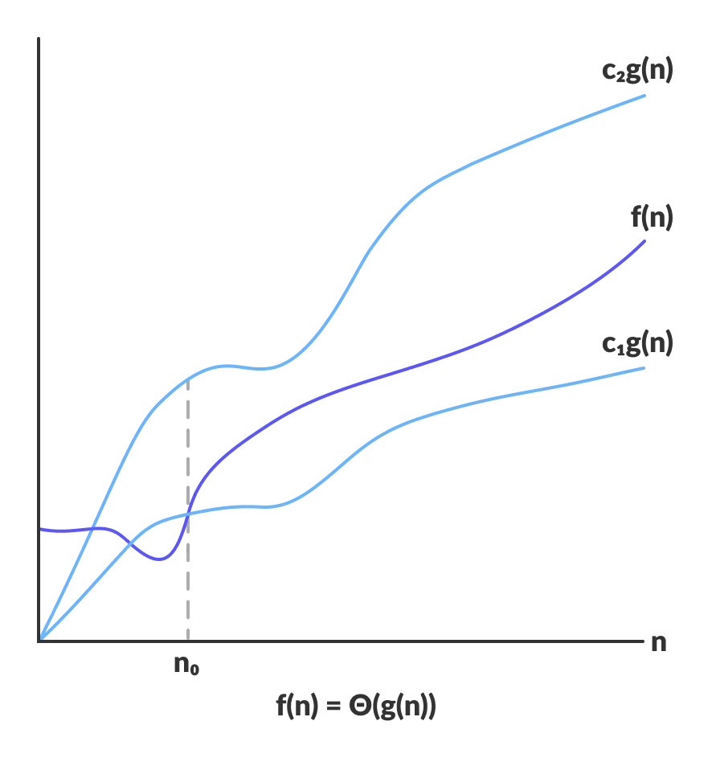
3. Theta Notation (Θ-notation)
Theta notation encloses the function from above and below.
Since it represents the upper and the lower bound of the running time of an algorithm, it is used for analyzing the average-case complexity of an algorithm.
Ex: Theta bounds the function within constants factors

Slide 34
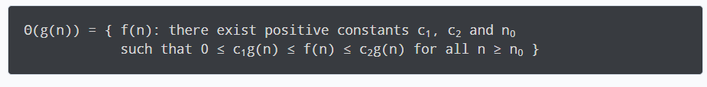
For a function g(n), Θ(g(n)) is given by the relation:
The above expression can be described as a function f(n) belongs to the set Θ(g(n)) if there exist positive constants c1 and c2 such that it can be sandwiched between c1g(n) and c2g(n), for sufficiently large n.
If a function f(n) lies anywhere in between c1g(n) and c2g(n) for all n ≥ n0, then f(n) is said to be asymptotically tight bound.

Slide 35
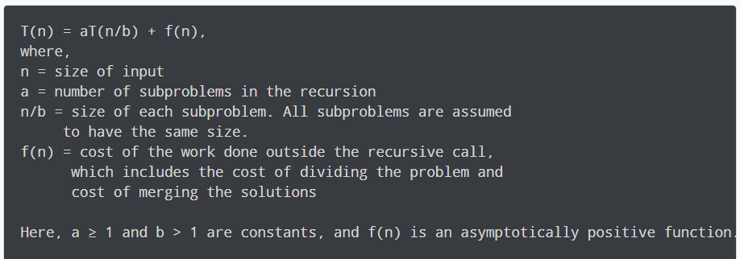
Master Theorem
The master method is a formula for solving recurrence relations of the form:
An asymptotically positive function means that for a sufficiently large value of n, we have f(n) > 0.
The master theorem is used in calculating the time complexity of recurrence relations (divide and conquer algorithms) in a simple and quick way.

Slide 36
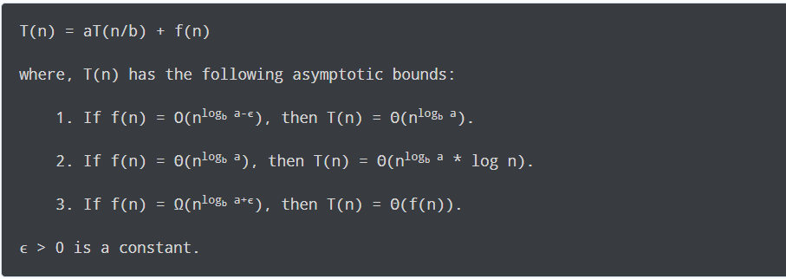
If a ≥ 1 and b > 1 are constants and f(n) is an asymptotically positive function, then the time complexity of a recursive relation is given by.

Slide 37
Each of the above conditions can be interpreted as:
If the cost of solving the sub-problems at each level increases by a certain factor, the value of f(n) will become polynomially smaller than n^{log}_{b} ª. Thus, the time complexity is oppressed by the cost of the last level ie. n^{log}_{b} ª
If the cost of solving the sub-problem at each level is nearly equal, then the value of f(n) will be n^{log}_{b} ª. Thus, the time complexity will be f(n) times the total number of levels ie. n^{log}_{b} ª * log n.
If the cost of solving the subproblems at each level decreases by a certain factor, the value of f(n) will become polynomially larger than n^{log}_{b} ª. Thus, the time complexity is oppressed by the cost of f(n).

Slide 38
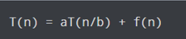
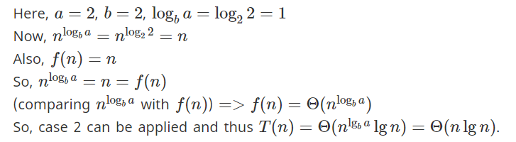
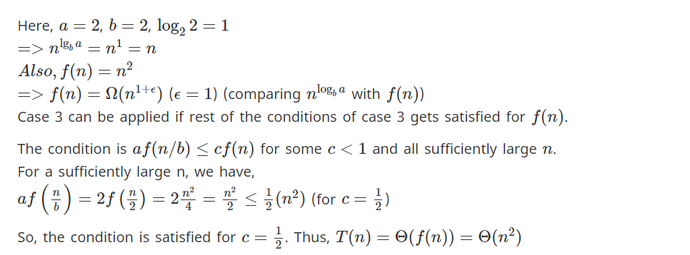
Example 1:
Example 2:

Slide 39
Divide and Conquer Algorithm
A divide and conquer algorithm is a strategy of solving a large problem by
1.breaking the problem into smaller sub-problems
2.solving the sub-problems, and
3.combining them to get the desired output.
To use the divide and conquer algorithm, recursion is used.

Slide 40
How Divide and Conquer Algorithms Work?
Here are the steps involved:
Divide: Divide the given problem into sub-problems using recursion.
Conquer: Solve the smaller sub-problems recursively. If the subproblem is small enough, then solve it directly.
Combine: Combine the solutions of the sub-problems that are part of the recursive process to solve the actual problem.

Slide 41
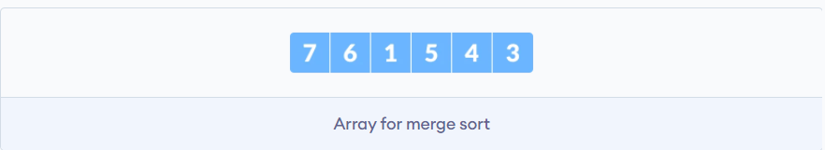
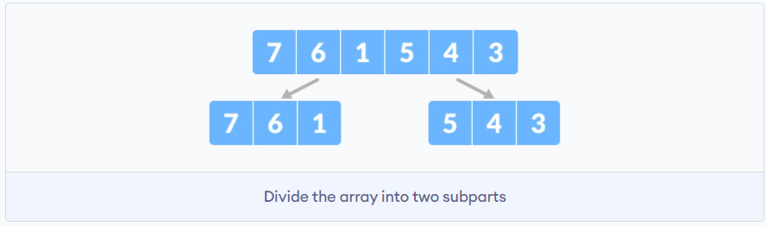
Example:
1.Let the given array be:
2. Divide the array into two halves.
Again, divide each subpart recursively into two halves until you get individual elements.

Slide 42
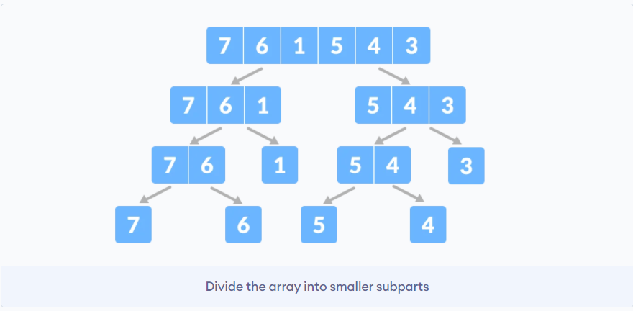
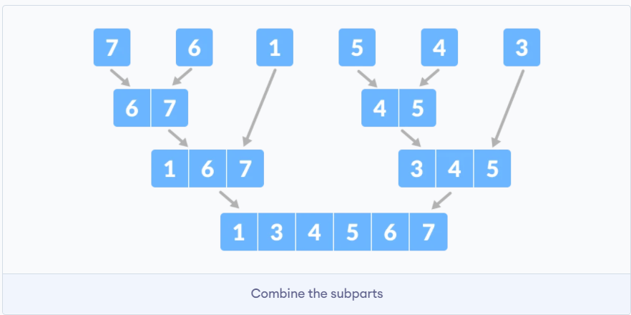
3.Now, combine the individual elements in a sorted manner. Here, conquer and combine steps go side by side.

Slide 43
Advantages of Divide and Conquer Algorithm
The complexity for the multiplication of two matrices using the naive method is 0(n³), whereas using the divide and conquer approach (i.e. Strassen's matrix multiplication) is 0(n^{2.8074}). This approach also simplifies other problems, such as the Tower of Hanoi.
This approach is suitable for multiprocessing systems.
It makes efficient use of memory caches.

Slide 44
Divide and Conquer Applications
Binary Search.
Merge Sort.
Quick Sort.
Strassen's Matrix multiplication.
Karatsuba Algorithm.

Slide 45
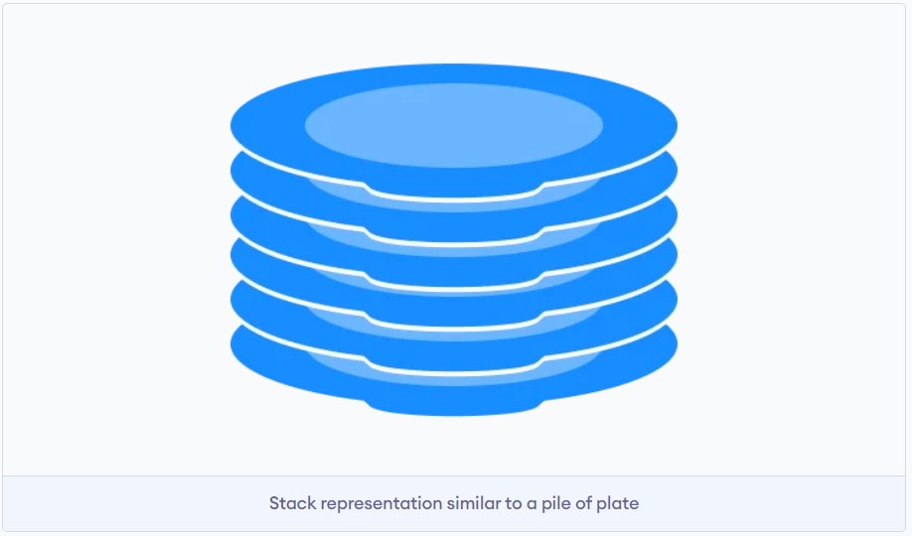
Stack Data Structure
A stack is a linear data structure that follows the principle of Last In First Out (LIFO). This means the last element inserted inside the stack is removed first.

Slide 46
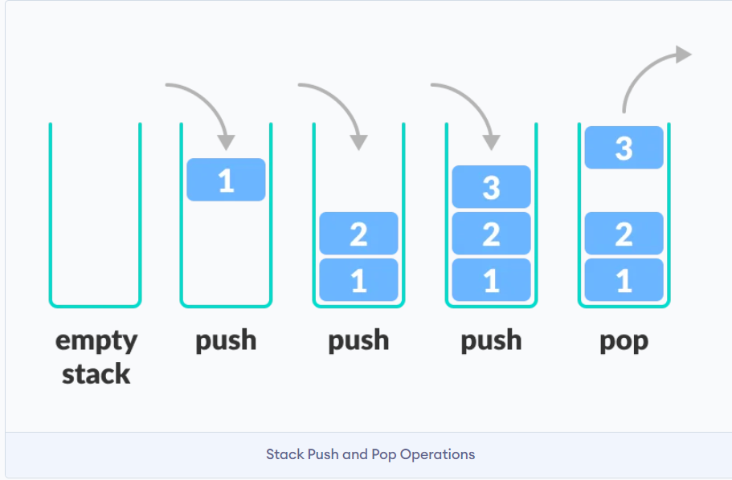
LIFO Principle of Stack
In programming terms, putting an item on top of the stack is called push and removing an item is called pop.

Slide 47
Basic Operations of Stack
There are some basic operations that allow us to perform different actions on a stack.
Push: Add an element to the top of a stack.
Pop: Remove an element from the top of a stack.
IsEmpty: Check if the stack is empty.
IsFull: Check if the stack is full.
Peek: Get the value of the top element without removing it.

Slide 48
Working of Stack Data Structure
The operations work as follows:
A pointer called TOP is used to keep track of the top element in the stack.
When initializing the stack, we set its value to -1 so that we can check if the stack is empty by comparing TOP == -1.
On pushing an element, we increase the value of TOP and place the new element in the position pointed to by TOP.
On popping an element, we return the element pointed to by TOP and reduce its value.
Before pushing, we check if the stack is already full.
Before popping, we check if the stack is already empty.

Slide 49
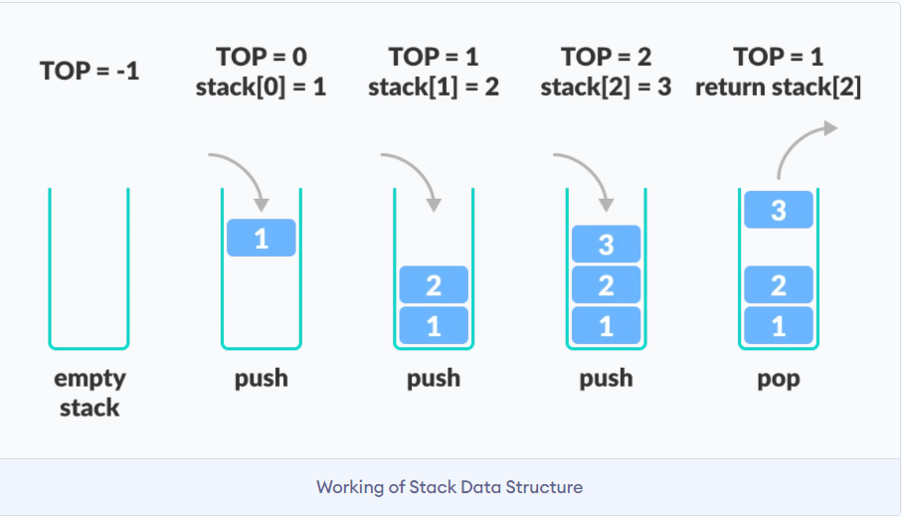

Slide 50
Applications of Stack Data Structure
To reverse a word - Put all the letters in a stack and pop them out. Because of the LIFO order of stack, you will get the letters in reverse order.
In compilers - Compilers use the stack to calculate the value of expressions like 2 + 4 / 5 * (7 - 9) by converting the expression to prefix or postfix form.
In browsers - The back button in a browser saves all the URLs you have visited previously in a stack. Each time you visit a new page, it is added on top of the stack. When you press the back button, the current URL is removed from the stack, and the previous URL is accessed.

Slide 51
Lab 1: Stack implementation in Java
Lab 1.1: Stack implementation using array.

Slide 52
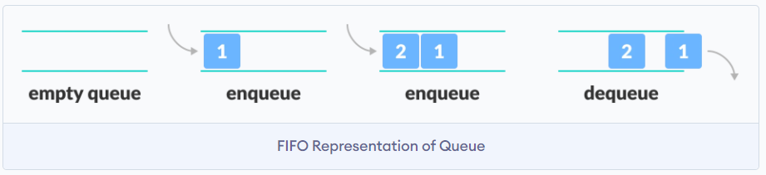
Queue Data Structure
A queue is a useful data structure in programming. It is similar to the ticket queue outside a cinema hall, where the first person entering the queue is the first person who gets the ticket.
Queue follows the First In First Out (FIFO) rule - the item that goes in first is the item that comes out first.

Slide 53
Basic Operations of Queue
A queue is an object (an abstract data structure - ADT) that allows the following operations:
Enqueue: Add an element to the end of the queue.
Dequeue: Remove an element from the front of the queue.
IsEmpty: Check if the queue is empty.
IsFull: Check if the queue is full.
Peek: Get the value of the front of the queue without removing it.

Slide 54
Working of Queue
Queue operations work as follows:
two pointers FRONT and REAR.
FRONT track the first element of the queue.
REAR track the last element of the queue.
initially, set value of FRONT and REAR to -1.

Slide 55
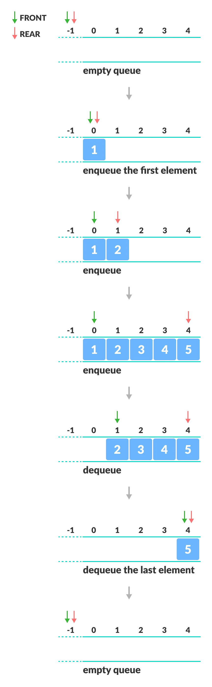
Ex: Enqueue and Dequeue Operations

Slide 56
Applications of Queue
CPU scheduling, Disk Scheduling
When data is transferred asynchronously between two processes.The queue is used for synchronization. For example: IO Buffers, pipes, file IO, etc
Handling of interrupts in real-time systems.
Call Center phone systems use Queues to hold people calling them in order.

Slide 57
Types of Queues
There are four different types of queues:
Simple Queue.
Circular Queue.
Priority Queue.
Double Ended Queue.

Slide 58
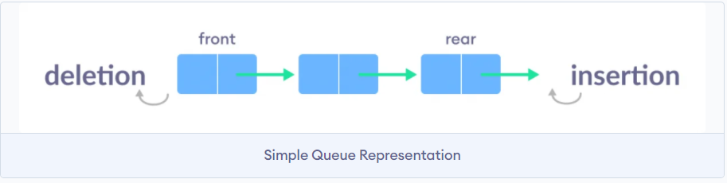
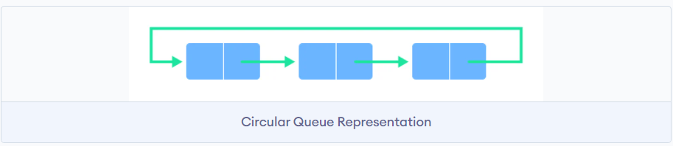
Simple Queue
Circular Queue

Slide 59
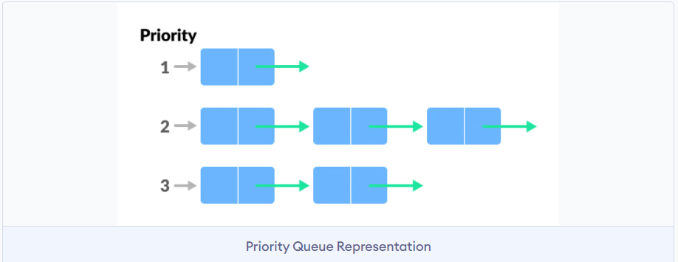
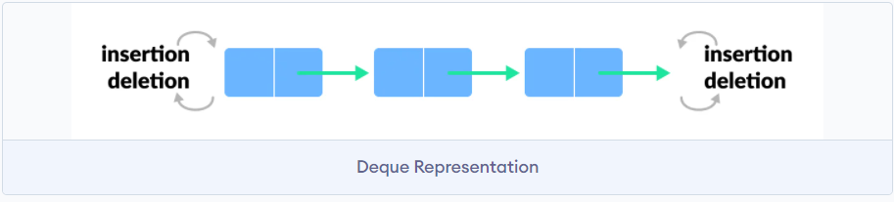
3. Priority Queue
4. Deque (Double Ended Queue)

Slide 60
Lab 2: Queue implementation in Java
Lab 2.1: Linear Queue implementation.
Lab 2.2: Circular Queue Implementation.
Lab 2.3: Queue Stack Implementation.

Slide 61
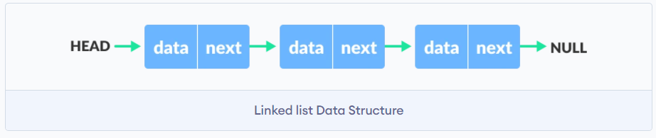
Linked list Data Structure
A linked list is a linear data structure that includes a series of connected nodes. Here, each node store the data and the address of the next node. For example,
Linked lists can be of multiple types: singly, doubly, and circular linked list.

Slide 62
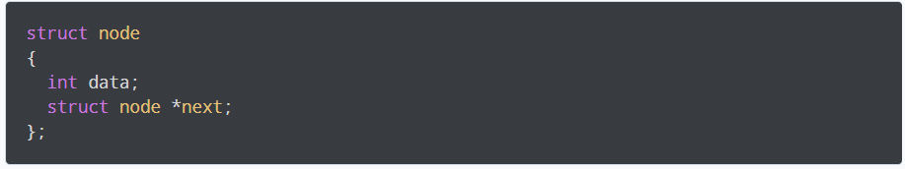
Representation of Linked List
Let's see how each node of the linked list is represented. Each node consists:
A data item.
An address of another node.
We wrap both the data item and the next node reference in a struct as:

Slide 63
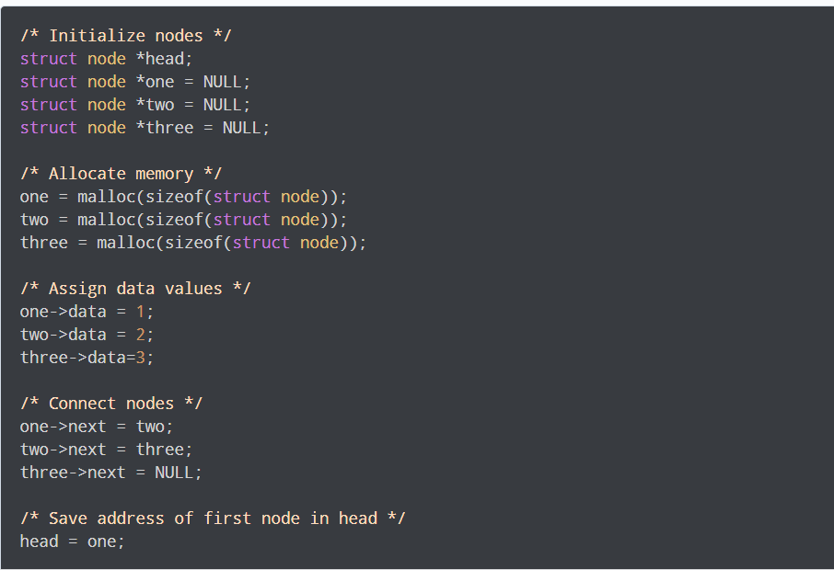
Each struct node has a data item and a pointer to another struct node. Let us create a simple Linked List with three items to understand how this works.

Slide 64
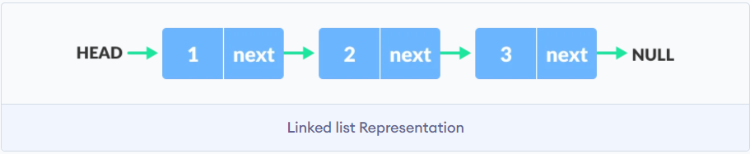
We have created a simple linked list with three nodes.

Slide 65
Linked List Applications
Dynamic memory allocation.
Implemented in stack and queue.
In undo functionality of software's.
Hash tables, Graphs.

Slide 66
Linked List Operations
There are various linked list operations that allow us to perform different actions on linked lists.
Traversal - access each element of the linked list.
Insertion - adds a new element to the linked list.
Deletion - removes the existing elements.
Search - find a node in the linked list.
Sort - sort the nodes of the linked list.

Slide 67
Types of Linked List
There are three common types of Linked List.
Singly Linked List.
Doubly Linked List.
Circular Linked List.

Slide 68
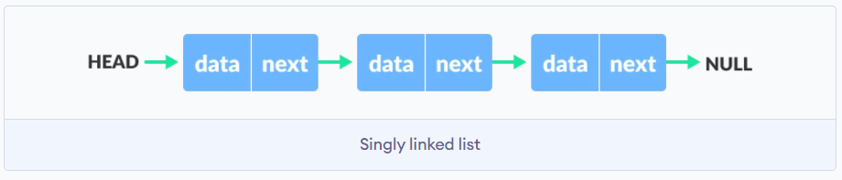
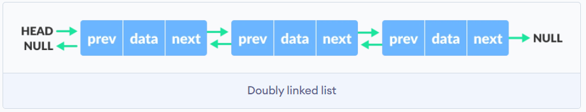
1. Singly Linked List
2. Doubly Linked List

Slide 69
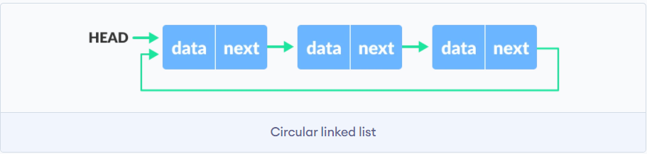
3. Circular Linked List

Slide 70
Lab: Linked list implementation in Java
Lab3.1: Implementation of Single LinkedList.
Lab3.2: Implementation of Double LinkedList.
Lab3.3: Implementation of Circular LinkedList.
Lab3.4: Implementation of Linked list operations.

Slide 71
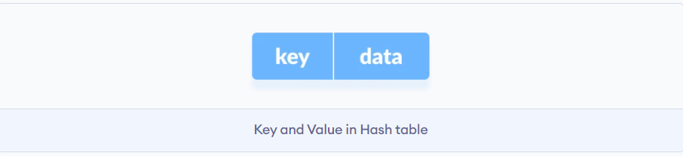
Hash Table
The Hash table data structure stores elements in key-value pairs where
Key- unique integer that is used for indexing the values
Value - data that are associated with keys.

Slide 72
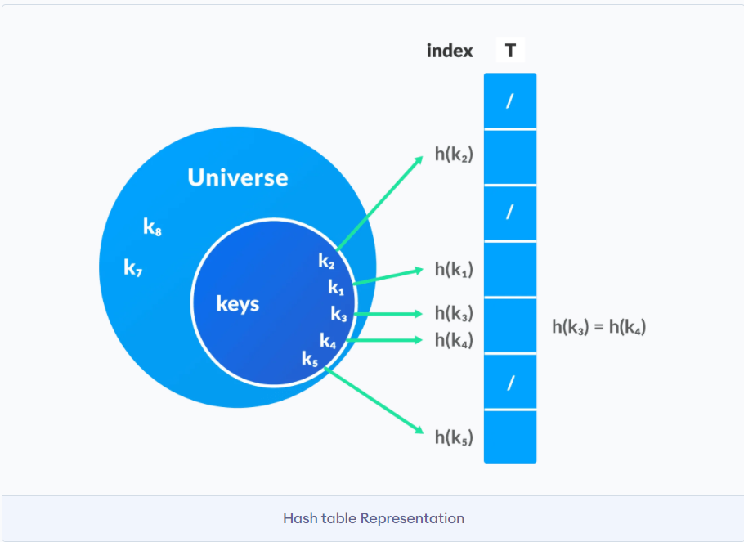
Hashing (Hash Function)
In a hash table, a new index is processed using the keys. And, the element corresponding to that key is stored in the index. This process is called hashing.
Let k be a key and h(x) be a hash function.
Here, h(k) will give us a new index to store the element linked with k.

Slide 73
Hash Collision
When the hash function generates the same index for multiple keys, there will be a conflict (what value to be stored in that index). This is called a hash collision.
We can resolve the hash collision using one of the following techniques.
Collision resolution by chaining.
Open Addressing: Linear/Quadratic Probing and Double Hashing.

Slide 74
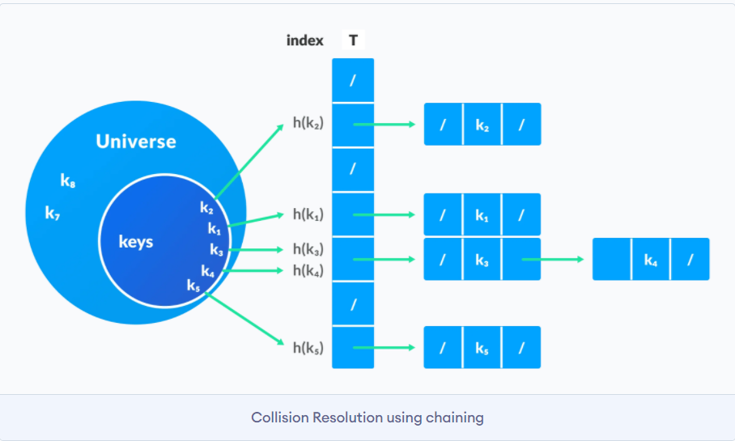
Collision resolution by chaining
In chaining, if a hash function produces the same index for multiple elements, these elements are stored in the same index by using a doubly-linked list.
If j is the slot for multiple elements, it contains a pointer to the head of the list of elements. If no element is present, j contains NIL.

Slide 75
2. Open Addressing
Unlike chaining, open addressing doesn't store multiple elements into the same slot. Here, each slot is either filled with a single key or left NIL.
Different techniques used in open addressing are:
Linear Probing.
Quadratic Probing.
Double hashing.

Slide 76
Applications of Hash Table
Hash tables are implemented where
constant time lookup and insertion is required.
cryptographic applications.
indexing data is required.

Slide 77
Lab: Java program to demonstrate working of Hash Table
Lab 4.1: Java program to demonstrate working of HashTable.

Slide 78
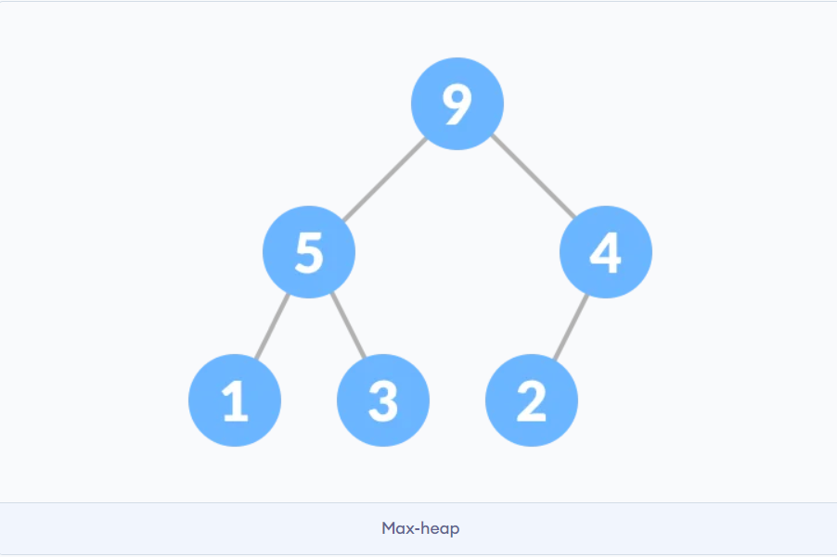
Heap Data Structure
Heap data structure is a complete binary tree that satisfies the heap property, where any given node is:
Always greater than its child node/s and the key of the root node is the largest among all other nodes. This property is also called max heap property.

Slide 79
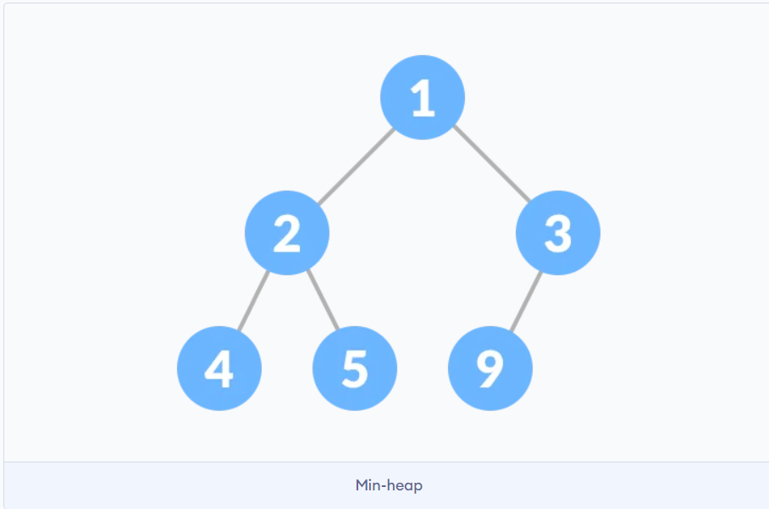
Heap Data Structure
Always smaller than the child node/s and the key of the root node is the smallest among all other nodes. This property is also called min heap property.

Slide 80
Heap Operations
Some of the important operations performed on a heap are:
Heapify.
Insert Element into Heap.
Delete Element from Heap.
Peek (Find max/min).
Extract-Max/Min.

Slide 81
Heap Data Structure Applications
Heap is used while implementing a priority queue.
Dijkstra's Algorithm.
Heap Sort.

Slide 82
Lab: Max-Heap data structure in Java
Lab 5.1: Implementation of Max-Heap data structure in Java.

Slide 83
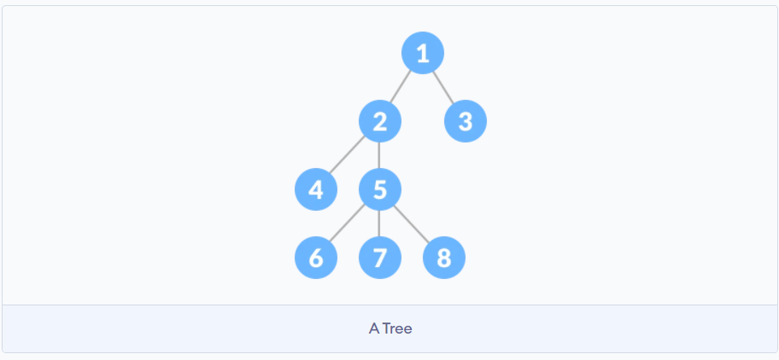
Tree Data Structure
A tree is a nonlinear hierarchical data structure that consists of nodes connected by edges.

Slide 84
Why Tree Data Structure?
Other data structures such as arrays, linked list, stack, and queue are linear data structures that store data sequentially.
In order to perform any operation in a linear data structure, the time complexity increases with the increase in the data size.
Different tree data structures allow quicker and easier access to the data as it is a non-linear data structure.

Slide 85
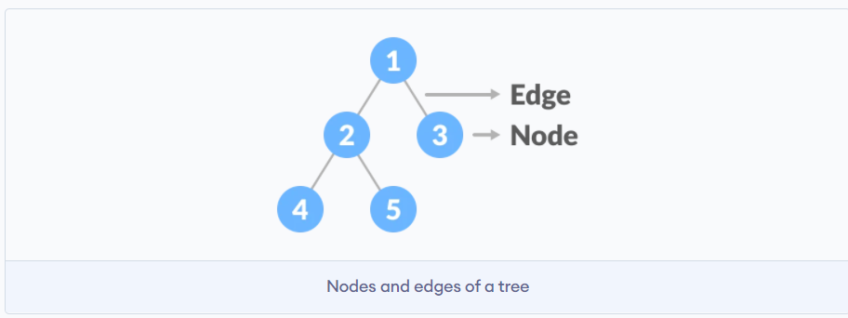
Tree Terminologies
Node: A node is an entity that contains a key or value and pointers to its child nodes.
Edge: It is the link between any two nodes.

Slide 86
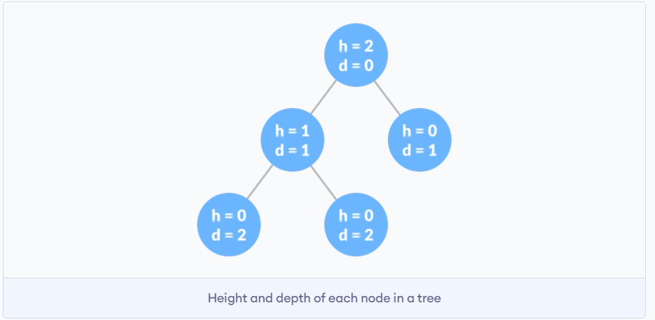
Tree Terminologies
Root: It is the topmost node of a tree.
Height of a Node: The height of a node is the number of edges from the node to the deepest leaf (ie. the longest path from the node to a leaf node).

Slide 87
Depth of a Node:The depth of a node is the number of edges from the root to the node.
Height of a Tree:The height of a Tree is the height of the root node or the depth of the deepest node.

Slide 88
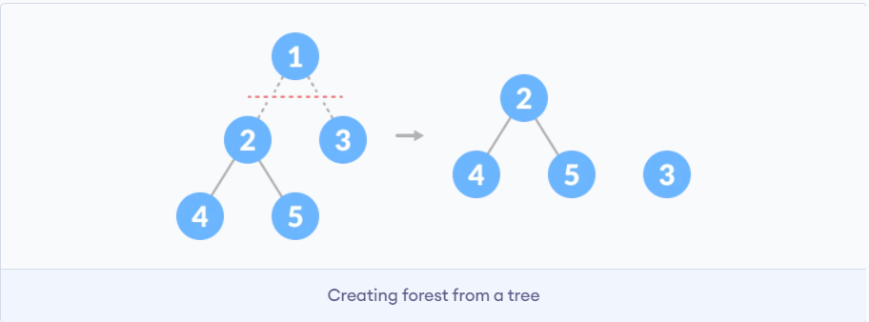
Degree of a Node: The degree of a node is the total number of branches of that node.
Forest: A collection of disjoint trees is called a forest.

Slide 89
Types of Tree
1.Binary Tree.
2.Binary Search Tree.
3.AVL Tree.
4.B-Tree.

Slide 90
Tree Applications
Binary Search Trees(BSTs) are used to quickly check if an element is present in a set or not.
Heap is a kind of tree that is used for heap sort.
A modified version of a tree called Tries is used in modern routers to store routing information.
Most popular databases use B-Trees and T-Trees, which are variants of the tree structure we learned above to store their data
Compilers use a syntax tree to validate the syntax of every program you write.

Slide 91
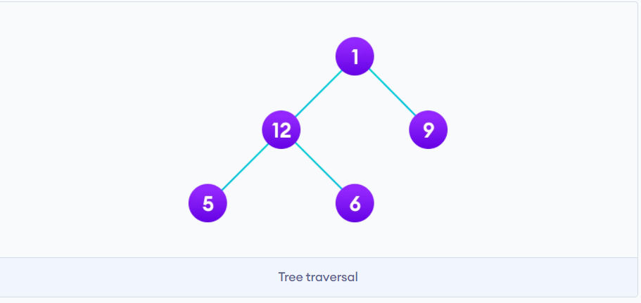
Tree Traversal
Traversing a tree means visiting every node in the tree.
You might, for instance, want to add all the values in the tree or find the largest one. For all these operations, you will need to visit each node of the tree.
Linear data structures like arrays, stacks, queues, and linked list have only one way to read the data. But a hierarchical data structure like a tree can be traversed in different ways.

Slide 92
Let's think about how we can read the elements of the tree in the image shown below.
Starting from top, Left to right.
Starting from bottom, Left to right.

Slide 93
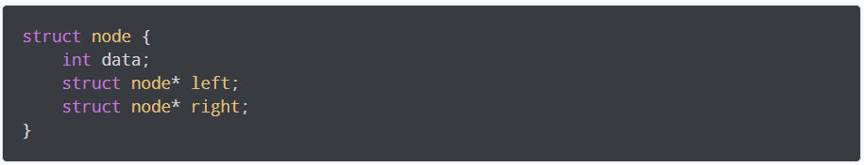
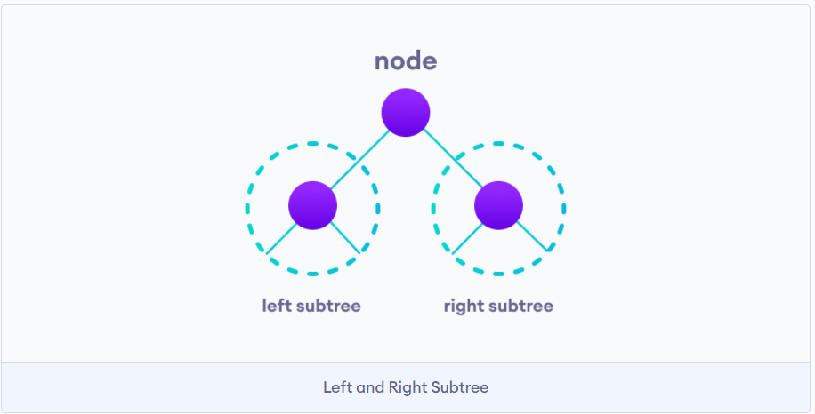
Although this process is somewhat easy, it doesn't respect the hierarchy of the tree, only the depth of the nodes.
Instead, we use traversal methods that take into account the basic structure of a tree i.e.
The struct node pointed to by left and right might have other left and right children so we should think of them as sub-trees instead of sub-nodes.

Slide 94

According to this structure, every tree is a combination of
A node carrying data.
Two subtrees.
Remember that our goal is to visit each node, so we need to visit:
all the nodes in the left subtree,
the root node and
all the nodes in the right subtree as well.

Slide 95
Depending on the order in which we do this, there can be three types of traversal.
Inorder traversal.
Preorder traversal
Postorder traversal.

Slide 96



Inorder traversal
First, visit all the nodes in the left subtree.
Then the root node.
Visit all the nodes in the right subtree.
2. Preorder traversal
Visit root node.
Visit all the nodes in the left subtree.
Visit all the nodes in the right subtree.
3. Postorder traversal
Visit all the nodes in the left subtree.
Visit all the nodes in the right subtree.
Visit the root node.

Slide 97
Lab: Tree traversal in Java
Lab 6.1: Implementation of Tree traversal in Java.
javac <filename.java>
java BinaryTree

Slide 98

Binary Tree
A binary tree is a tree data structure in which each parent node can have at most two children. Each node of a binary tree consists of three items:
data item.
address of left child.
address of right child.

Slide 99

Types of Binary Tree
1.Full Binary Tree
A Full Binary tree is a special type of binary tree in which every parent node/internal node has either two or no children.

Slide 100

2. Perfect Binary Tree
A perfect binary tree is a type of binary tree in which every internal node has exactly two child nodes and all the leaf nodes are at the same level.

Slide 101

3. Complete Binary Tree
A complete binary tree is just like a full binary tree, but with two major differences
Every level must be completely filled.
All the leaf elements must lean towards the left.
The last leaf element might not have a right sibling i.e. a complete binary tree doesn't have to be a full binary tree.

Slide 102

4. Degenerate or Pathological Tree
A degenerate or pathological tree is the tree having a single child either left or right.

Slide 103

5. Skewed Binary Tree
A skewed binary tree is a pathological/degenerate tree in which the tree is either dominated by the left nodes or the right nodes. Thus, there are two types of skewed binary tree:
left-skewed binary tree
right-skewed binary tree.

Slide 104

6. Balanced Binary Tree
It is a type of binary tree in which the difference between the height of the left and the right subtree for each node is either 0 or 1.

Slide 105


Binary Tree Representation
A node of a binary tree is represented by a structure containing a data part and two pointers to other structures of the same type.

Slide 106
Binary Tree Applications
For easy and quick access to data.
In router algorithms.
To implement heap data structure.
Syntax tree.

Slide 107
Lab: Binary Tree in Java
Lab 7.1: Implementation of Binary Tree in Java.
javac <filename.java>
java BinaryTree

Slide 108

Full Binary Tree
A full Binary tree is a special type of binary tree in which every parent node/internal node has either two or no children.
It is also known as a proper binary tree.

Slide 109


Full Binary Tree Theorems
i=3, n=7, l=4, λ=3

Slide 110
Lab: Checking if a binary tree is a full binary tree in Java
Lab 8.1: Implementation of check if a binary tree is a full binary tree in Java.
javac <filename.java>
java BinaryTree

Slide 111

Perfect Binary Tree
A perfect binary tree is a type of binary tree in which every internal node has exactly two child nodes and all the leaf nodes are at the same level.
All the internal nodes have a degree of 2.

Slide 112

Recursively, a perfect binary tree can be defined as:
If a single node has no children, it is a perfect binary tree of height h = 0,
If a node has h > 0, it is a perfect binary tree if both of its subtrees are of height h - 1 and are non-overlapping.

Slide 113

Perfect Binary Tree Theorems
A perfect binary tree of height h has $2^{h+1}$ – 1 node.
A perfect binary tree with n nodes has height log(n + 1) – 1 = Θ(ln(n)).
A perfect binary tree of height h has $2^{h}$ leaf nodes.
The average depth of a node in a perfect binary tree is Θ(ln(n)).

Slide 114
Lab: Checking if a binary tree is a perfect binary tree in Java
Lab 9.1: Implementation of check if a binary tree is a perfect binary tree in Java.

Slide 115

Complete Binary Tree
A complete binary tree is a binary tree in which all the levels are completely filled except possibly the lowest one, which is filled from the left.
A complete binary tree is just like a full binary tree, but with two major differences
All the leaf elements must lean towards the left.
The last leaf element might not have a right sibling i.e. a complete binary tree doesn't have to be a full binary tree.

Slide 116


How a Complete Binary Tree is Created?
Select the first element of the list to be the root node. (no. of elements on level-I: 1).
Put the second element as a left child of the root node and the third element as the right child. (no. of elements on level-II: 2).

Slide 117

Put the next two elements as children of the left node of the second level. Again, put the next two elements as children of the right node of the second level (no. of elements on level-III: 4) elements).
Keep repeating until you reach the last element.

Slide 118
Complete Binary Tree Applications
Heap-based data structures.
Heap sort.

Slide 119
Lab: Checking if a binary tree is a complete binary tree in Java
Lab 10.1: Implementation of check if a binary tree is a complete binary tree in Java.
javac <filename.java>
java BinaryTree

Slide 120
Balanced Binary Tree
A balanced binary tree, also referred to as a height-balanced binary tree, is defined as a binary tree in which the height of the left and right subtree of any node differ by not more than 1.
Following are the conditions for a height-balanced binary tree:
Difference between the left and the right subtree for any node is not more than one.
The left subtree is balanced.
The right subtree is balanced.

Slide 121



Slide 122
Balanced Binary Tree Applications
AVL tree.
Balanced Binary Search Tree.

Slide 123
Lab: Checking if a binary tree is height balanced in Java
Lab 11.1: Implementation of check if a binary tree is a height balanced binary tree in Java.

Slide 124
Binary Search Tree(BST)
Binary search tree is a data structure that quickly allows us to maintain a sorted list of numbers.
It is called a binary tree because each tree node has a maximum of two children.
It is called a search tree because it can be used to search for the presence of a number in O(log(n)) time.
The properties that separate a binary search tree from a regular binary tree is
All nodes of left subtree are less than the root node.
All nodes of right subtree are more than the root node.
Both subtrees of each node are also BSTs i.e. they have the above two properties.

Slide 125


Slide 126
Binary Search Tree Applications
In multilevel indexing in the database.
For dynamic sorting.
For managing virtual memory areas in Unix kernel.

Slide 127
Lab: Binary Search Tree operations in java
Lab 12.1: To implement Binary Search Tree operations in java.

Slide 128
AVL Tree
AVL tree is a self-balancing binary search tree in which each node maintains extra information called a balance factor whose value is either -1, 0 or +1.
AVL tree got its name after its inventor Georgy Adelson-Velsky and Landis.

Slide 129

B-tree
B-tree is a special type of self-balancing search tree in which each node can contain more than one key and can have more than two children. It is a generalized form of the binary search tree.
It is also known as a height-balanced m-way tree.

Slide 130
B-tree Properties
For each node x, the keys are stored in increasing order.
In each node, there is a boolean value x.leaf which is true if x is a leaf.
If n is the order of the tree, each internal node can contain at most n - 1 keys along with a pointer to each child.
Each node except root can have at most n children and at least n/2 children.
All leaves have the same depth (i.e. height-h of the tree).
The root has at least 2 children and contains a minimum of 1 key.
If n ≥ 1, then for any n-key B-tree of height h and minimum degree t ≥ 2, h ≥ log_{t} (n+1)/2.

Slide 131
Operations on a B-tree
Searching an element in a B-tree
Searching for an element in a B-tree is the generalized form of searching an element in a Binary Search Tree.
The following steps are followed.
Starting from the root node, compare k with the first key of the node.
If k = the first key of the node, return the node and the index.
If k.leaf = true, return NULL (i.e. not found).
If k < the first key of the root node, search the left child of this key recursively.
If there is more than one key in the current node and k > the first key, compare k with the next key in the node.
If k < next key, search the left child of this key (ie. k lies in between the first and the second keys).
Else, search the right child of the key.
Repeat steps 1 to 4 until the leaf is reached.

Slide 132


Searching Example
Let us search key k = 17 in the tree below of degree 3.
Compare it with the root key, k is not found in the root.

Slide 133


Since k > 11, go to the right child of the root node.
Compare k with 16. Since k > 16, compare k with the next key 18.

Slide 134


Since k < 18, k lies between 16 and 18. Search in the right child of 16 or the left child of 18.
k is found.

Slide 135
B Tree Applications
Databases and file systems.
To store blocks of data (secondary storage media).
Multilevel indexing.

Slide 136
Lab: Searching a key on a B-tree in Java
Lab 13.1: Implementation to search a key on a B-tree in java.

Slide 137
Insertion into a B-tree
Inserting an element on a B-tree consists of two events:
searching the appropriate node to insert the element and
splitting the node if required.
Insertion operation always takes place in the bottom-up approach.

Slide 138
Insertion Operation
If the tree is empty, allocate a root node and insert the key.
Update the allowed number of keys in the node.
Search the appropriate node for insertion.
If the node is full, follow the steps below.
Insert the elements in increasing order.
Now, there are elements greater than its limit. So, split at the median.
Push the median key upwards and make the left keys as a left child and the right keys as a right child.
If the node is not full, follow the steps below.
Insert the node in increasing order.

Slide 139

Insertion Example
Ex: Inserting elements into a B-Tree

Slide 140
Lab: Inserting a key on a B-tree in Java
Lab 14.1: Implementation to insert a key on a B-tree in Java

Slide 141
Deletion from a B-tree
Deleting an element on a B-tree consists of three main events: searching the node where the key to be deleted exists, deleting the key and balancing the tree if required.
While deleting a tree, a condition called underflow may occur. Underflow occurs when a node contains less than the minimum number of keys it should hold.
The terms to be understood before studying deletion operation are:
Inorder Predecessor
The largest key on the left child of a node is called its inorder predecessor.
Inorder Successor
The smallest key on the right child of a node is called its inorder successor.

Slide 142
Deletion Operation
Before going through the steps below, one must know these facts about a B tree of degree m.
A node can have a maximum of m children. (i.e. 3)
A node can contain a maximum of m - 1 keys. (i.e. 2)
A node should have a minimum of ⌈m/2⌉ children. (i.e. 2)
A node (except root node) should contain a minimum of ⌈m/2⌉ - 1 keys. (i.e. 1)

Slide 143
Lab: Deleting a key on a B-tree in Java
Lab 15.1 : Implementation to delete a key on a B-tree in Java.

Slide 144

Graph Data Structure
A graph data structure is a collection of nodes that have data and are connected to other nodes.
Let's try to understand this through an example. On facebook, everything is a node. That includes User, Photo, Album, Event, Group, Page, Comment, Story, Video, Link, Note...anything that has data is a node.
Every relationship is an edge from one node to another. Whether you post a photo, join a group, like a page, etc., a new edge is created for that relationship.

Slide 145


More precisely, a graph is a data structure (V, E) that consists of
A collection of vertices V.
A collection of edges E, represented as ordered pairs of vertices (u,v).

Slide 146
Graph Terminology
Adjacency: A vertex is said to be adjacent to another vertex if there is an edge connecting them. Vertices 2 and 3 are not adjacent because there is no edge between them.
Path: A sequence of edges that allows you to go from vertex A to vertex B is called a path. 0-1, 1-2 and 0-2 are paths from vertex 0 to vertex 2.
Directed Graph: A graph in which an edge (u,v) doesn't necessarily mean that there is an edge (v, u) as well. The edges in such a graph are represented by arrows to show the direction of the edge.

Slide 147

Graph Representation
1. Adjacency Matrix
An adjacency matrix is a 2D array of V x V vertices. Each row and column represent a vertex.
If the value of any element a[i][j] is 1, it represents that there is an edge connecting vertex i and vertex j.

Slide 148

2. Adjacency List
An adjacency list represents a graph as an array of linked lists.
The index of the array represents a vertex and each element in its linked list represents the other vertices that form an edge with the vertex.

Slide 149
Graph Operations
The most common graph operations are:
Check if the element is present in the graph.
Graph Traversal.
Add elements(vertex, edges) to graph.
Finding the path from one vertex to another.

Slide 150

Spanning Tree and Minimum Spanning Tree
Spanning tree
A spanning tree is a sub-graph of an undirected connected graph, which includes all the vertices of the graph with a minimum possible number of edges. If a vertex is missed, then it is not a spanning tree.
The edges may or may not have weights assigned to them.
The total number of spanning trees with n vertices that can be created from a complete graph is equal to $n^{(n−2)}$.
If we have n = 4, the maximum number of possible spanning trees is equal to $4^{4−2}$ = 16. Thus, 16 spanning trees can be formed from a complete graph with 4 vertices.

Slide 151
Minimum Spanning Tree
A minimum spanning tree is a spanning tree in which the sum of the weight of the edges is as minimum as possible.
Spanning Tree Applications
Computer Network Routing Protocol.
Cluster Analysis.
Civil Network Planning.
Minimum Spanning tree Applications
To find paths in the map.
To design networks like telecommunication networks, water supply networks, and electrical grids.

Slide 152

Strongly Connected Components
A strongly connected component is the portion of a directed graph in which there is a path from each vertex to another vertex. It is applicable only on a directed graph.
For example:
Let us take the graph below.

Slide 153

The strongly connected components of the above graph are:
You can observe that in the first strongly connected component, every vertex can reach the other vertex through the directed path.

Slide 154

Kosaraju's Algorithm
Kosaraju's Algorithm is based on the depth-first search algorithm implemented twice.
Three steps are involved.
1. Perform a depth first search on the whole graph.
2. Reverse the original graph.
3. Perform depth-first search on the reversed graph.

Slide 155
Strongly Connected Components Applications
Vehicle routing applications.
Maps.
Model-checking in formal verification.

Slide 156
Depth First Search (DFS)
Depth first Search or Depth first traversal is a recursive algorithm for searching all the vertices of a graph or tree data structure. Traversal means visiting all the nodes of a graph.
A standard DFS implementation puts each vertex of the graph into one of two categories:
Visited.
Not Visited.

Slide 157
Working DFS algorithm
Start by putting any one of the graph's vertices on top of a stack.
Take the top item of the stack and add it to the visited list.
Create a list of that vertex's adjacent nodes. Add the ones which aren't in the visited list to the top of the stack.
Keep repeating steps 2 and 3 until the stack is empty.

Slide 158
Lab: DFS algorithm in Java
Lab 16.1: DFS algorithm in Java.

Slide 159
Sorting and Searching Algorithms
Bubble Sort
Bubble sort is a sorting algorithm that compares two adjacent elements and swaps them until they are not in the intended order.
Just like the movement of air bubbles in the water that rise up to the surface, each element of the array move to the end in each iteration. Therefore, it is called a bubble sort.

Slide 160

Working of Bubble Sort
1. First Iteration (Compare and Swap)
Starting from the first index, compare the first and the second elements.
If the first element is greater than the second element, they are swapped.
Now, compare the second and the third elements. Swap them if they are not in order.
The above process goes on until the last element.

Slide 161

2. Remaining Iteration
The same process goes on for the remaining iterations.
After each iteration, the largest element among the unsorted elements is placed at the end.

Slide 162

In each iteration, the comparison takes place up to the last unsorted element.

Slide 163

The array is sorted when all the unsorted elements are placed at their correct positions.

Slide 164

Bubble Sort Algorithm

Slide 165
Lab : Bubble sort in Java
Lab 17.1: Implementation of Bubble sort in Java.

Slide 166
Optimized Bubble Sort Algorithm
In the Bubble sort algorithm, all the comparisons are made even if the array is already sorted.
This increases the execution time.
To solve this, we can introduce an extra variable swapped. The value of swapped is set true if there occurs swapping of elements. Otherwise, it is set false.
After an iteration, if there is no swapping, the value of swapped will be false. This means elements are already sorted and there is no need to perform further iterations.
This will reduce the execution time and helps to optimize the bubble sort.

Slide 167

Algorithm for optimized bubble sort

Slide 168

Bubble Sort Complexity

Slide 169


Bubble Sort compares the adjacent elements.
Hence, the number of comparisons is nearly equals to $n^{2}$
Hence, Complexity: 0($n^{2}$)
Also, if we observe the code, bubble sort requires two loops. Hence, the complexity is n*n = $n^{2}$

Slide 170

Time Complexities
Worst Case Complexity: O($n^{2}$)
If we want to sort in ascending order and the array is in descending order then the worst case occurs.
Best Case Complexity: O($n$)
If the array is already sorted, then there is no need for sorting.
Average Case Complexity: O($n^{2}$)
It occurs when the elements of the array are in jumbled order (neither ascending nor descending).

Slide 171
2. Space Complexity
Space complexity is O(1) because an extra variable is used for swapping.
In the optimized bubble sort algorithm, two extra variables are used. Hence, the space complexity will be O(2).

Slide 172
Bubble Sort Applications
Bubble sort is used if
Complexity does not matter.
Short and simple code is preferred.

Slide 173
Lab : Optimized Bubble sort in Java
Lab 18.1: Implementation of Optimized Bubble sort in Java.

Slide 174

2. Selection Sort Algorithm
Selection sort is a sorting algorithm that selects the smallest element from an unsorted list in each iteration and places that element at the beginning of the unsorted list.
Working of Selection Sort
Set the first element as minimum.
Compare minimum with the second element. If the second element is smaller than minimum, assign the second element as minimum.Compare minimum with the third element. Again, if the third element is smaller, then assign minimum to the third element otherwise do nothing. The process goes on until the last element.

Slide 175


3. After each iteration, minimum is placed in the front of the unsorted list.

Slide 176




4. For each iteration, indexing starts from the first unsorted element. Step 1 to 3 are repeated until all the elements are placed at their correct positions.

Slide 177

Selection Sort Algorithm

Slide 178



Selection Sort Complexity
Number of comparisons: (n - 1) + (n - 2) + (n - 3) + ..... + 1 = n(n - 1) / 2 nearly equals to $n^{2}$.
Complexity = 0($n^{2}$)
Also, we can analyze the complexity by simply observing the number of loops. There are 2 loops so the complexity is n*n = $n^{2}$ .

Slide 179

Time Complexities:
Worst Case Complexity: 0($n^{2}$)
If we want to sort in ascending order and the array is in descending order then, the worst case occurs.
Best Case Complexity: O0$n^{2}$)
It occurs when the array is already sorted
Average Case Complexity: 0($n^{2}$)
It occurs when the elements of the array are in jumbled order (neither ascending nor descending).
Space Complexity:
Space complexity is 0(1) because an extra variable temp is used.

Slide 180

Selection Sort Applications
The selection sort is used when
a small list is to be sorted.
cost of swapping does not matter.
checking of all the elements is compulsory.
cost of writing to a memory matters like in flash memory (number of writes/swaps is O(n) as compared to O($n^{2}$) of bubble sort).

Slide 181
Lab : Selection sort in Java
Lab 19.1: Implementation of selection sort in Java.

Slide 182
3. Insertion Sort Algorithm
Insertion sort is a sorting algorithm that places an unsorted element at its suitable place in each iteration.
Insertion sort works similarly as we sort cards in our hand in a card game.

Slide 183


Working of Insertion Sort
Suppose we need to sort the following array.
1. The first element in the array is assumed to be sorted. Take the second element and store it separately in key. Compare key with the first element. If the first element is greater than key, then key is placed in front of the first element.

Slide 184

2. Now, the first two elements are sorted. Take the third element and compare it with the elements on the left of it. Placed it just behind the element smaller than it. If there is no element smaller than it, then place it at the beginning of the array.

Slide 185


3. Similarly, place every unsorted element at its correct position.

Slide 186


Insertion Sort Algorithm
Insertion Sort Complexity

Slide 187

Time Complexities
Worst Case Complexity: O($n^{2}$)
Suppose, an array is in ascending order, and you want to sort it in descending order. In this case, worst case complexity occurs.
Each element has to be compared with each of the other elements so, for every nth element, (n-1) number of comparisons are made.
Thus, the total number of comparisons = n*(n-1) ~ $n^{2}$
Best Case Complexity: O(n)
When the array is already sorted, the outer loop runs for n number of times whereas the inner loop does not run at all. So, there are only n number of comparisons. Thus, complexity is linear.
Average Case Complexity: O($n^{2}$)
It occurs when the elements of an array are in jumbled order (neither ascending nor descending).
Space Complexity
Space complexity is O(1) because an extra variable key is used.

Slide 188
Insertion Sort Applications
The insertion sort is used when:
The array is has a small number of elements.
There are only a few elements left to be sorted.

Slide 189
Lab: Insertion sort in Java
Lab 20.1: Implementation of Insertion sort in Java.

Slide 190

4. Merge Sort Algorithm
Merge Sort is one of the most popular sorting algorithms that is based on the principle of Divide and Conquer Algorithm.
Here, a problem is divided into multiple sub-problems. Each sub-problem is solved individually. Finally, sub-problems are combined to form the final solution.

Slide 191
Divide and Conquer Strategy
Using the Divide and Conquer technique, we divide a problem into subproblems. When the solution to each subproblem is ready, we 'combine' the results from the subproblems to solve the main problem.
Suppose we had to sort an array A. A subproblem would be to sort a sub-section of this array starting at index p and ending at index r, denoted as A[p..r].
Divide
If q is the half-way point between p and r, then we can split the subarray A[p..r] into two arrays A[p..q] and A[q+1, r].
Conquer
In the conquer step, we try to sort both the subarrays A[p..q] and A[q+1, r]. If we haven't yet reached the base case, we again divide both these subarrays and try to sort them.
Combine
When the conquer step reaches the base step and we get two sorted subarrays A[p..q] and A[q+1, r] for array A[p..r], we combine the results by creating a sorted array A[p..r] from two sorted subarrays A[p..q] and A[q+1, r].

Slide 192


Merge( ) Function
The array A[0..5] contains two sorted subarrays A[0..3] and A[4..5]. Let us see how the merge function will merge the two arrays.

Slide 193




Step 1: Create duplicate copies of sub-arrays to be sorted.
Step 2: Maintain current index of sub-arrays and main array.

Slide 194


Step 3: Until we reach the end of either L or M, pick larger among elements L and M and place them in the correct position at A[p..r].

Slide 195


Step 4: When we run out of elements in either L or M, pick up the remaining elements and put in A[p..r].

Slide 196

This step would have been needed if the size of M was greater than L.
At the end of the merge function, the subarray A[p..r] is sorted.

Slide 197

Merge Sort Complexity
Time Complexity
Best Case Complexity: 0(n*log n)
Worst Case Complexity: 0(n*log n)
Average Case Complexity: 0(n*log n)
Space Complexity:
The space complexity of merge sort is 0(n).

Slide 198
Merge Sort Applications
Inversion count problem.
External sorting.
E-commerce applications.

Slide 199
Lab : Merge sort in Java
Lab 21.1: Implementation of merge sort in java.

Slide 200
5. Bucket Sort Algorithm
Bucket Sort is a sorting algorithm that divides the unsorted array elements into several groups called buckets. Each bucket is then sorted by using any of the suitable sorting algorithms or recursively applying the same bucket algorithm.
Finally, the sorted buckets are combined to form a final sorted array.
Scatter Gather Approach
The process of bucket sort can be understood as a scatter-gather approach. Here, elements are first scattered into buckets then the elements in each bucket are sorted. Finally, the elements are gathered in order.

Slide 201


Slide 202


Working of Bucket Sort
1.Suppose, the input array is:
Create an array of size 10. Each slot of this array is used as a bucket for storing elements.

Slide 203

2. Insert elements into the buckets from the array. The elements are inserted according to the range of the bucket.
In our example code, we have buckets each of ranges from 0 to 1, 1 to 2, 2 to 3,...... (n-1) to n.
Suppose, an input element is .23 is taken. It is multiplied by size = 10 (ie. .23*10=2.3). Then, it is converted into an integer (ie. 2.3≈2). Finally, .23 is inserted into bucket-2.

Slide 204

Similarly, .25 is also inserted into the same bucket. Everytime, the floor value of the floating point number is taken.
If we take integer numbers as input, we have to divide it by the interval (10 here) to get the floor value.
Similarly, other elements are inserted into their respective buckets.

Slide 205


3. The elements of each bucket are sorted using any of the stable sorting algorithms. Here, we have used quicksort (inbuilt function).
4.The elements from each bucket are gathered.
It is done by iterating through the bucket and inserting an individual element into the original array in each cycle. The element from the bucket is erased once it is copied into the original array.

Slide 206


Bucket Sort Algorithm
Bucket Sort Complexity

Slide 207
Bucket Sort Applications
Bucket sort is used when:
input is uniformly distributed over a range.
there are floating point values.

Slide 208
Lab : Bucket sort in Java
Lab 22.1: Implementation of Bucket sort in java.

Slide 209
6. Heap Sort Algorithm
Heap Sort is a popular and efficient sorting algorithm in computer programming. Learning how to write the heap sort algorithm requires knowledge of two types of data structures - arrays and trees.
The initial set of numbers that we want to sort is stored in an array e.g. [10, 3, 76, 34, 23, 32] and after sorting, we get a sorted array [3,10,23,32,34,76].
Heap sort works by visualizing the elements of the array as a special kind of complete binary tree called a heap.

Slide 210
What is Heap Data Structure?
Heap is a special tree-based data structure.
A binary tree is said to follow a heap data structure if
It is a complete binary tree
All nodes in the tree follow the property that they are greater than their children i.e. the largest element is at the root and both its children and smaller than the root and so on. Such a heap is called a max-heap. If instead, all nodes are smaller than their children, it is called a min-heap.

Slide 211

The following example diagram shows Max-Heap and Min-Heap.

Slide 212
Working of Heap Sort
Since the tree satisfies Max-Heap property, then the largest item is stored at the root node.
Swap: Remove the root element and put at the end of the array (nth position) Put the last item of the tree (heap) at the vacant place.
Remove: Reduce the size of the heap by 1.
Heapify: Heapify the root element again so that we have the highest element at root.
The process is repeated until all the items of the list are sorted.

Slide 213








Ex: Swap, Remove, and Heapify

Slide 214

Heap Sort Complexity
Heap Sort has O(nlog n) time complexities for all the cases ( best case, average case, and worst case).

Slide 215
Lab: Heap Sort in Java
Lab 23.1: Implementation of Heap sort in java.

Slide 216

7. Linear Search
Linear search is a sequential searching algorithm where we start from one end and check every element of the list until the desired element is found. It is the simplest searching algorithm.
How Linear Search Works?
The following steps are followed to search for an element k = 1 in the list below.

Slide 217


1.Start from the first element, compare k with each element x.
2.If x == k, return the index.
3. Else, return not found.

Slide 218

Linear Search Algorithm
Linear Search Complexities
Time Complexity: 0(n)
Space Complexity: 0(1)
Linear Search Applications
For searching operations in smaller arrays (<100 items).

Slide 219
Lab : Linear Search in Java
Lab 24.1: Implementation of linear search in java.

Slide 220
8. Binary Search
Binary Search is a searching algorithm for finding an element's position in a sorted array.
In this approach, the element is always searched in the middle of a portion of an array.
Binary Search Algorithm can be implemented in two ways which are discussed below.
Iterative Method
Recursive Method
The recursive method follows the divide and conquer approach.

Slide 221


The general steps for both methods are discussed below.
The array in which searching is to be performed is:
Let x = 4 be the element to be searched.
2. Set two pointers low and high at the lowest and the highest positions respectively.

Slide 222


3. Find the middle element mid of the array ie. arr[(low + high)/2] = 6.
4.If x == mid, then return mid. Else, compare the element to be searched with m.
5.If x > mid, compare x with the middle element of the elements on the right side of mid. This is done by setting low to low = mid + 1.
6.Else, compare x with the middle element of the elements on the left side of mid. This is done by setting high to high = mid - 1.

Slide 223


7. Repeat steps 3 to 6 until low meets high.
8. x = 4 is found.

Slide 224

Binary Search Algorithm

Slide 225
Binary Search Complexity
Time Complexities
Best case complexity: 0(1)
Average case complexity: 0(log n)
Worst case complexity: 0(log n)
Space Complexity
The space complexity of the binary search is 0(1).

Slide 226
Binary Search Applications
In libraries of Java, .Net, C++, STL – Standard Template Library
While debugging, the binary search is used to pinpoint the place where the error happens.

Slide 227
Lab : Binary Search in java using Iterative Method
Lab 25.1: Implementation of binary search in java using Iterative method.

Slide 228
Lab : Binary Search in java using Recursive Method
Lab 25.2: Implementation of binary search in java using Iterative method.

Slide 229
Greedy Algorithm
A greedy algorithm is an approach for solving a problem by selecting the best option available at the moment. It doesn't worry whether the current best result will bring the overall optimal result.
The algorithm never reverses the earlier decision even if the choice is wrong. It works in a top-down approach.
This algorithm may not produce the best result for all the problems. It's because it always goes for the local best choice to produce the global best result.

Slide 230
However, we can determine if the algorithm can be used with any problem if the problem has the following properties:
1. Greedy Choice Property
If an optimal solution to the problem can be found by choosing the best choice at each step without reconsidering the previous steps once chosen, the problem can be solved using a greedy approach. This property is called greedy choice property.
2. Optimal Substructure
If the optimal overall solution to the problem corresponds to the optimal solution to its subproblems, then the problem can be solved using a greedy approach. This property is called optimal substructure.

Slide 231
Advantages of Greedy Approach
The algorithm is easier to describe.
This algorithm can perform better than other algorithms (but, not in all cases).

Slide 232

Greedy Approach
1. Let's start with the root node 20. The weight of the right child is 3 and the weight of the left child is 2.
2. Our problem is to find the largest path. And, the optimal solution at the moment is 3. So, the greedy algorithm will choose 3.
3. Finally the weight of an only child of 3 is 1. This gives us our final result 20 + 3 + 1 = 24.
However, it is not the optimal solution. There is another path that carries more weight (20 + 2 + 10 = 32) as shown in the image below.

Slide 233
Greedy Algorithm
To begin with, the solution set (containing answers) is empty.
At each step, an item is added to the solution set until a solution is reached.
If the solution set is feasible, the current item is kept.
Else, the item is rejected and never considered again.

Slide 234

Ford-Fulkerson Algorithm
Ford-Fulkerson algorithm is a greedy approach for calculating the maximum possible flow in a network or a graph.
A term, flow network, is used to describe a network of vertices and edges with a source (S) and a sink (T). Each vertex, except S and T, can receive and send an equal amount of stuff through it. S can only send and T can only receive stuff.

Slide 235
Terminologies Used
Augmenting Path
It is the path available in a flow network.
Residual Graph
It represents the flow network that has additional possible flow.
Residual Capacity
It is the capacity of the edge after subtracting the flow from the maximum capacity.

Slide 236

How Ford-Fulkerson Algorithm works?
The algorithm follows:
Initialize the flow in all the edges to 0.
While there is an augmenting path between the source and the sink, add this path to the flow.
Update the residual graph.
Ford-Fulkerson Example
The flow of all the edges is 0 at the beginning.

Slide 237


1.Select any arbitrary path from S to T. In this step, we have selected path S-A-B-T.
The minimum capacity among the three edges is 2 (B-T). Based on this, update the flow/capacity for each path.

Slide 238


2. Select another path S-D-C-T. The minimum capacity among these edges is 3 (S-D).
Update the capacities according to this.

Slide 239


3.Now, let us consider the reverse-path B-D as well. Selecting path S-A-B-D-C-T. The minimum residual capacity among the edges is 1 (D-C).
Updating the capacities.
The capacity for forward and reverse paths are considered separately.

Slide 240
4. Adding all the flows = 2 + 3 + 1 = 6, which is the maximum possible flow on the flow network.
Ford-Fulkerson Applications
Water distribution pipeline.
Bipartite matching problem.
Circulation with demands.

Slide 241
Lab: Ford-Fulkerson algorithm in Java

Slide 242
Dijkstra's Algorithm
Dijkstra's algorithm allows us to find the shortest path between any two vertices of a graph.
It differs from the minimum spanning tree because the shortest distance between two vertices might not include all the vertices of the graph.

Slide 243

How Dijkstra's Algorithm works
Dijkstra's Algorithm works on the basis that any subpath B -> D of the shortest path A -> D between vertices A and D is also the shortest path between vertices B and D.
Djikstra used this property in the opposite direction i.e we overestimate the distance of each vertex from the starting vertex. Then we visit each node and its neighbors to find the shortest subpath to those neighbors.
The algorithm uses a greedy approach in the sense that we find the next best solution hoping that the end result is the best solution for the whole problem.

Slide 244




Example of Dijkstra's algorithm
It is easier to start with an example and then think about the algorithm.

Slide 245





Slide 246
Dijkstra's Algorithm Complexity
Time Complexity: O(E Log V)
where, E is the number of edges and V is the number of vertices.
Space Complexity: O(V)
Dijkstra's Algorithm Applications
To find the shortest path.
In social networking applications.
In a telephone network.
To find the locations in the map.

Slide 247
Lab : Dijkstra's Algorithm in Java
Lab 26.1: Implement Dijkstra's Algorithm in Java.

Slide 248
Kruskal's Algorithm
Kruskal's algorithm is a minimum spanning tree algorithm that takes a graph as input and finds the subset of the edges of that graph which
form a tree that includes every vertex.
has the minimum sum of weights among all the trees that can be formed from the graph.

Slide 249
How Kruskal's algorithm works
It falls under a class of algorithms called greedy algorithms that find the local optimum in the hopes of finding a global optimum.
We start from the edges with the lowest weight and keep adding edges until we reach our goal.

Slide 250
The steps for implementing Kruskal's algorithm are as follows:
Sort all the edges from low weight to high.
Take the edge with the lowest weight and add it to the spanning tree. If adding the edge created a cycle, then reject this edge.
Keep adding edges until we reach all vertices.

Slide 251




Example of Kruskal's algorithm

Slide 252


Kruskal's Algorithm Complexity
The time complexity Of Kruskal's Algorithm is: O(E log E).
Kruskal's Algorithm Applications
In order to layout electrical wiring.
In computer network (LAN connection).

Slide 253
Lab: Kruskal's algorithm in Java
Lab 26.2: Implement Kruskal's algorithm in Java.

